Slide 1
Ethical Presentation
By Brian, Froilan, Lisa, Pedro and Raissa

Slide 2
Greed is good?
https://www.youtube.com/watch?v=R8y6DJAeolo
Enron was a corrupt corporation run by greed with the goal to make a profit.

Slide 3
The Beginning Presages The End
Enron was a Houston-based natural gas pipeline company
Born from the merger of Natural Gas and InterNorth in 1985
Federal deregulation of gas pipeline in the 1990s
Jeffrey Skilling created the “Gas Bank”
Enron was heavily involved in energy brokering, electronic energy trading, etc.
Enron became the 7th largest U.S. Company in 2001

Slide 4
The Best, The Brightest and The Dreaded PRC
Skilling changed the corporate culture of Enron
Hired Andrew Fastow, in 1990
Skilling: trading operation; Fastow: financing
Skilling instituted the Performance Review Committee (PRC)
Employees were regularly rated on a scale
Highly restrictive confidentiality clauses in trading contracts

Slide 5
How High They Fly
U.S. economy was experiencing the longest bull market in its history.
In 1996 Skilling became Enron’s chief operating officer.
Gas bank model could be applied to the market for electric energy as well.
Create a market for: paper, steel, water and even weather.

Slide 6
How High They Fly
Enron’s most exciting development was the creation of Enron Online (EOL).
Enron and Blockbuster announced a deal to provide video on demand via high-speed Internet lines.
Touted by Fortune as one of the most admired and innovative companies in the world.

Slide 7
Mark-to-Market Accounting
What is mark-to-market accounting?
Enron began using mark-to-market accounting when Jeff Skilling joined the company.
Enron inflated earnings using mark-to-market accounting.
Investors were given misleading financial reports.

Slide 8
Capitalism at Work
Profit margins began eroding, end of 2000
Profit margins ran with increasing leverage
Energy prices fall, first quarter of 2001
Deals were made quickly without regards
“Good deal vs. bad deal” + NPV
Foundations slowly developed cracks

Slide 9
Capitalism at Work
World economy headed into recession
Dampened energy market volatility
Reduced opportunity for Enron’s profitable gains

Slide 10
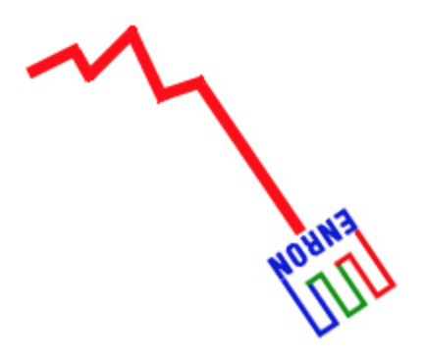
Obscure Disclosures Revealed
Doubt on the quality of the company’s earnings and on the business purpose of the transaction.
A number of analysts questioned the lack of transparency of Enron’s disclosures.
The market was beginning to perceive the company with greater skepticism.
Trust and reputation of the company were eroding .

Slide 11
Complex Special Purpose Entities
What is a special purpose entity?
Enron used hundreds of special purpose entities.
JEDI, Chewco, Whitewing, LJM Cayman.
Again investors are given misleading financial reports.

Slide 12
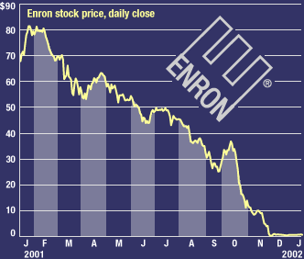
It All Comes Tumbling Down
February 2001 - Skilling was named the president and CEO
Stock’s price started to decrease
August 2001 - Skilling himself resigned
October 2001 - First quarterly loss in more than four years
Changes on employees pension plan

Slide 13
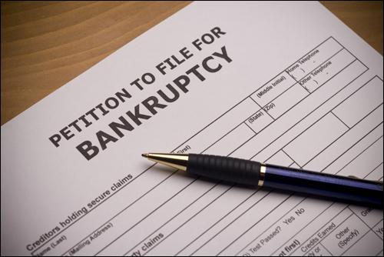
It All Comes Tumbling Down
November 2001 - restatement of its financial statements
$591 million in losses over the four years
$628 million in liabilities
Stock price: less than $10 a share
November 30 - stock closed at $0.26 a share
December 2 - the company filed for bankruptcy protection

Slide 14
The Aftermath
threatened financial markets in U.S. & abroad
GAO requested documents from White House
impact of Enron hit the government
Justice Department opened a criminal investigation
deep ties with the government
Kenneth Lay resigned as Enron’s CEO

Slide 15
AICPA
American Institute of Certified Public Accountants
engaged in damage control
12/2001 issued toolkit for auditors use
01/2002 board of directors would fully cooperate
approved a resolution to support prohibitions

Slide 16
Where were the Auditors?
Arthur Andersen, LLC
External and Internal Accountants are former Andersen Executives
Auditor-firm relationship conflict

Slide 17
Did we learn anything?
Sarbanes-Oxley Act of 2002
Keep your integrity
Never take customer and employee confidence for granted.

Slide 18
Works Cited
Healy, P. M., & Palepu, K. G. (2003). The fall of enron. The Journal of Economic Perspectives, 17(2), 3-26. Retrieved from http://search.proquest.com/docview/212077863?accountid=7285
Benston, George J, and Al L Hartgraves. "Enron: What Happened and What We Can Learn from It." Journal of Accounting and Public Policy, 21.2 (2002): 105-127.
"Enron." The Social History of Crime and Punishment in America, (2012)
Regan, MC. "Teaching Enron." Fordham Law Review, 74.3 (2005): 1139-1249.
Chandra, Gyan. "The Enron Implosion and Its Lessons." Journal of Management Research, 3.2 (2003): 98.

Slide 19
Questions?
?

